Slide 1
Fault Tolerance
a “fault” is the failure of some component of a distributed system
failure may or may not lead to the system or applications failing
systems that can continue to operate correctly despite failure of components, are said to be fault-tolerant
Building a dependable system is all about preventing and managing faults
Notes:
if probability p of failing in any given second, then mean time to failure is 1/p

Slide 2
Dependable Systems
Availability, Reliability, Safety, Maintainability
Availability
At any instance, is the system “up”
Defined in terms of an interval of time
Reliability
How long will it run for when it is up?
System can run continuously without failure?
Defined in terms of an instant of time
Safety
If failure occurs, does anything really bad happen?
eg: a nuclear power plant may need 100% safety
Maintainability
How easily can faults be repaired?

Slide 3
Dependable Systems (2)
Reliability: Difference between reliability and availability
a system goes down for one ms ever hour
highly available (99.9%) , but highly unreliable
a system never crashes but needs 1 day/month maintenance
highly reliable, not highly-available

Slide 4
Classification of faults
Transient, Intermittent, Permanent
Transient faults
the failure is temporary: it happens once, goes away, then doesn’t necessarily happen again
Intermittent faults
failures may go away by themselves, but they reoccur at intervals
e.g. loose power cord
Permanent fault
requires that the component be explicitly repaired
e.g. power cord is cut in two

Slide 5
Failure Model
Processes may fail
Communication channels may fail
The failure model describes various types of failures
Notes:
5

Slide 6
Processes and channels
Process Omission Failures
Communication Omission Failures
Arbitrary Failures
Timing Failures in Synchronized Systems
Notes:
6

Slide 7
Omission and Arbitrary Failures
Class of failure
Affects
Description
Fail-stop
Process
Process halts and remains halted. Other processes may
detect this state.
Crash
Process
Process halts and remains halted. Other processes may
not be able to detect this state.
Omission
Channel
A message inserted in an outgoing message buffer never
arrives at the other end’s incoming message buffer.
Send-
omission
Process
A process completes a
send,
but the message is not put
in its outgoing message buffer.
Receive-
omission
Process
A message is put in a process’s incoming message
buffer, but that process does not receive it.
Arbitrary
Process or
Process/channel exhibits arbitrary behaviour: it may
(Byzantine)
channel
send/transmit arbitrary messages at arbitrary times,
commit omissions; a process may stop or take an
incorrect step.
Notes:
7

Slide 8
Synchronous Model Timing Failures
Class of Failure
Affects
Description
Clock
Process
Process’s local clock exceeds the bounds on its
rate of drift from real time.
Performance
Process
Process exceeds the bounds on the interval
between two steps.
Performance
Channel
A message’s transmission takes longer than the
stated bound.
Notes:
8

Slide 9
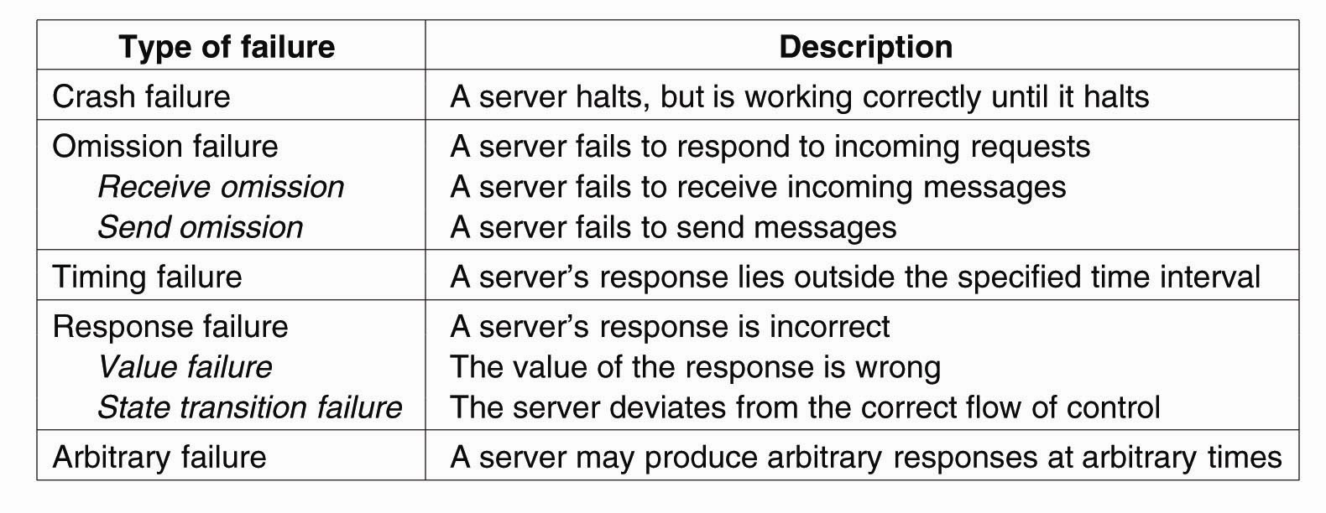
Failure Models
A system is said to fail if it cannot meet its promises. An error on the part of a system’s state may lead to a failure. The cause of an error is called a fault.

Slide 10
Failure Masking by Redundancy
the obvious thing to do to make systems fault tolerant, is to eliminate dependence on any particular component or event
There are three types of redundancy
types of redundancy
information redundancy
send more information to make sure what you receive is correct
time redundancy
re-issue requests at a later time, if they are not completed
physical redundancy
add extra processors (or other components)
active replication vs. primary backup

Slide 11
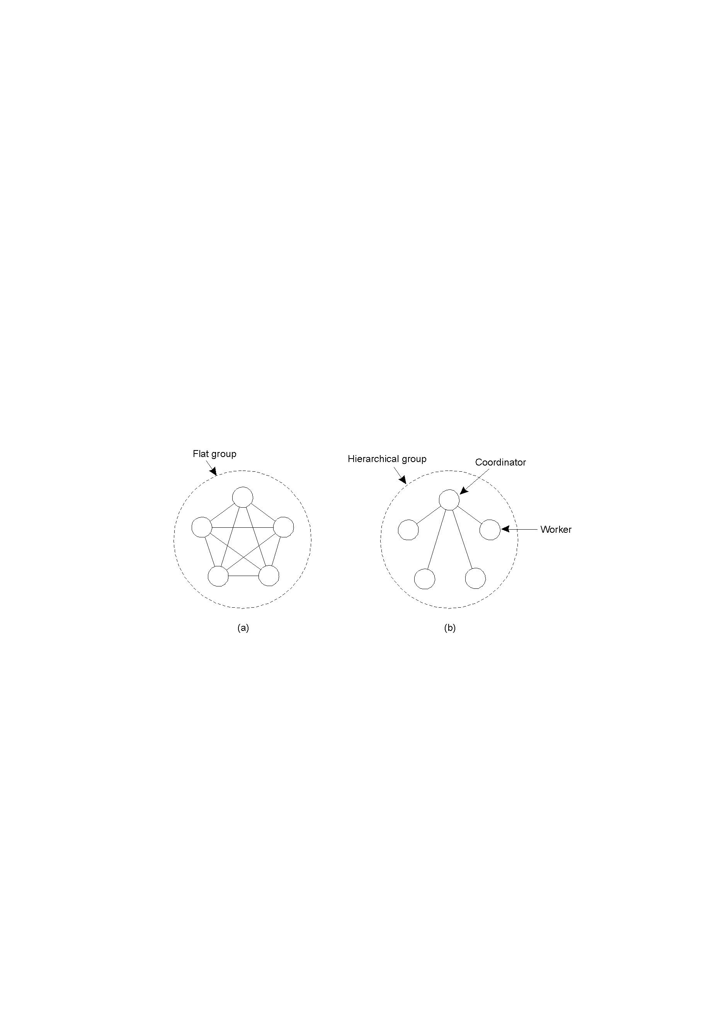
Process Resilience
Basic issue: Protect yourself against faulty processes by replicating and distributing computations in a group.
Flat groups: Good for fault tolerance as information exchange immediately occurs with all group members; however, may impose more overhead as control is completely distributed (hard to implement).
Hierarchical groups: All communication through a single coordinator⇒not really fault tolerant and scalable, but relatively easy to implement.
Communication in a flat group.
Communication in a simple
hierarchical group

Slide 12
Processes in Groups
Processes fail, so organize them in groups
send messages to the entire group
hopefully a process in the group can take over
A process may belong to several groups
Flat groups:
no coordinator
no single point of failure
decision making is more complicated
Hierarchical groups:
requests to the group and from within the group are sent to the coordinator
single point of failure
decision making is fast and easy
Notes:
Social life: people belong to music club, dance club, CS club
Decision making in hierarchical groups: just one person has to make it

Slide 13
Agreement in Faulty Systems
Two Army Problem
suppose we have two Blue armies with 10K troops each
one Red army with 15K troops separates them
coordinated Blue army attack defeats the Red army
the Blue armies can only communicate via messenger
messenger does not necessarily get through (communication may be faulty)
can you come up with an algorithm for the Blue armies to coordinate an attack?

Slide 14
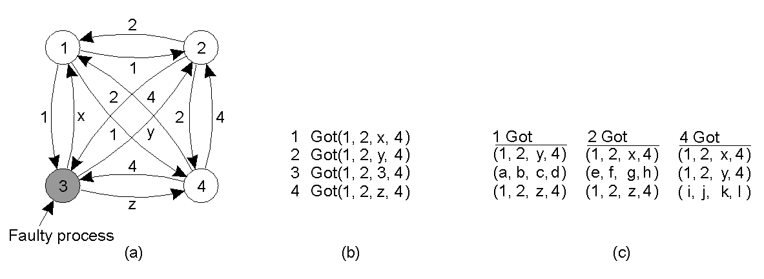
Agreement in Faulty Systems
The Byzantine generals problem for 3 loyal generals and1 traitor.
The generals announce their troop strengths (in units of 1 kilosoldiers).
The vectors that each general assembles based on (a)
The vectors that each general receives
If any value has a majority, that value is put into the result vector. If no value has a majority, the corresponding element of the result vector is marked UNKNOWN. We see that generals 1,2 and 4 all come to agreement on
(1,2, UNKNOWN,4) which is the correct result.

Slide 15
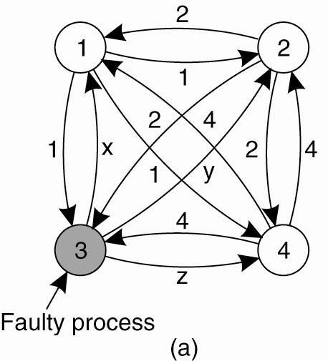
Agreement in Faulty Systems
System of N processes, where
each process i will provide a value v_{i} to each other. Some number of these processes may be incorrect (or malicious)
Goal: Each process learn the true values sent by each of the correct processes
The Byzantine agreement problem for three nonfaulty and one faulty process.

Slide 16
Byzantine agreement Algorithm
Phase 1: Each process sends its value to the other processes
Phase 2: Each process uses the messages to create a vector of responses – must be a default value for missing messages
Phase 3: Each process sends its vector to all other processes.
Phase 4: Each process the information received from every other process to do its computation.

Slide 17
Impossibility Results
General 1
General 1
attack
attack
attack
retreat
General 2
General 3
General 2
General 3
retreat
retreat
No solution for three processes can handle a single traitor.
In a system with m faulty processes agreement can be achieved
only if there are 2m+1 (more than 2/3) functioning correctly.

Slide 18
Byzantine Agreement Algorithm (oral messages) - 1
Phase 1: Each process sends its value to the other processes.
Correct processes send the same (correct) value to all.
Faulty processes may send different values to each if desired (or no message).
Assumptions: 1) Every message that is sent is delivered correctly; 2) The receiver of a message knows who sent it; 3) The absence of a message can be detected.

Slide 19
Byzantine General Problem: Example - 1
Phase 1: Generals announce their troop strengths to each other
1
P1
P2
1
1
P3
P4

Slide 20
Byzantine General Problem: Example - 2
Phase 1: Generals announce their troop strengths to each other
2
P1
P2
2
2
P3
P4

Slide 21
Byzantine General Problem: Example - 3
Phase 1: Generals announce their troop strengths to each other
P1
P2
4
4
4
P3
P4

Slide 22
Byzantine Agreement Algorithm (oral messages) - 2
Phase 2: Each process uses the messages to create a vector of responses – must be a default value for missing messages.
Assumptions: 1) Every message that is sent is delivered correctly; 2) The receiver of a message knows who sent it; 3) The absence of a message can be detected.

Slide 23
Byzantine General Problem: Example - 4
Phase 2: Each general construct a vector with all troops
P1 | P2 | P3 | P4
1 | 2 | y | 4
P1 | P2 | P3 | P4
1 | 2 | x | 4
P1
P2
x
y
z
P1 | P2 | P3 | P4
1 | 2 | z | 4
P3
P4

Slide 24
Byzantine Agreement Algorithm (oral messages) - 3
Phase 3: Each process sends its vector to all other processes.
Phase 4: Each process the information received from every other process to do its computation.
Assumptions: 1) Every message that is sent is delivered correctly; 2) The receiver of a message knows who sent it; 3) The absence of a message can be detected.

Slide 25
Byzantine General Problem
Phase 3,4: Generals send their vectors to each other and compute majority voting
P1 | P2 | P3 | P4
1 | 2 | x | 4
e | f | g | h
1 | 2 | z | 4
P1 | P2 | P3 | P4
1 | 2 | y | 4
a | b | c | d
1 | 2 | z | 4
P1
P2
P1
P2
P3
P3
P4
P4
(a, b, c, d)
(1, 2, ?, 4)
(1, 2, ?, 4)
(e, f, g, h)
P1 | P2 | P3 | P4
1 | 2 | x | 4
1 | 2 | y | 4
h | i | j | k
(h, i, j, k)
P3
P4
P1
P2
P3
(1, 2, ?, 4)

